Slide 2
Faith
Hope
Love
And now these three remain: faith, hope and love. But the greatest of these is love

Slide 3
Joseph’s love for Mary
Mary’s love for Jesus
God’s love for sinners
Our love for one another.

Slide 4
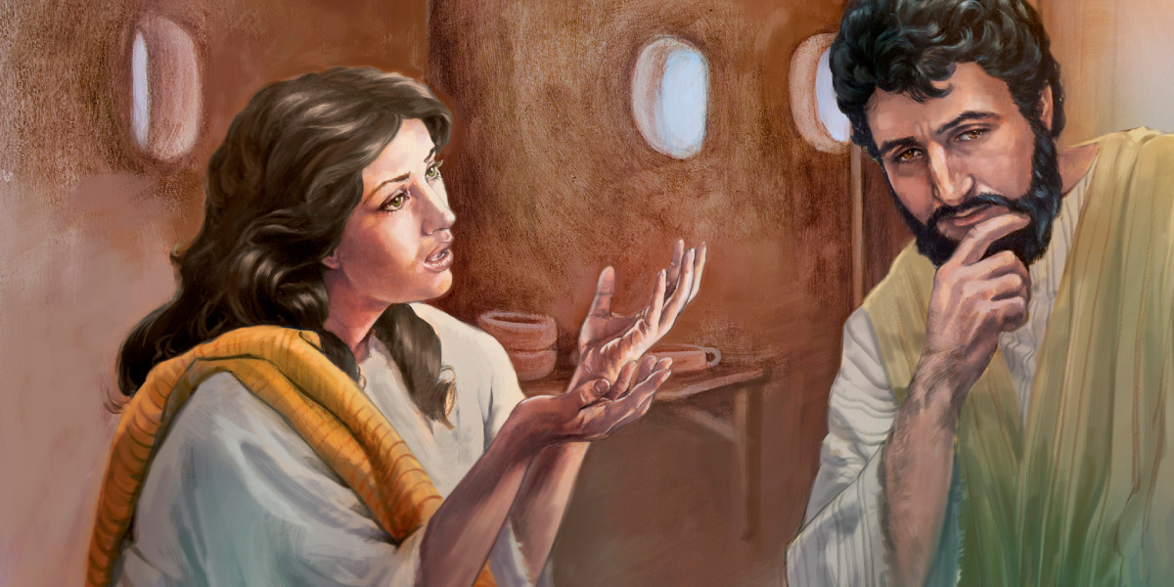
1. Joseph’s love for Mary

Slide 5
Matthew 1:18-19
This is how the birth of Jesus the Messiah came about: His mother Mary was pledged to be married to Joseph, but before they came together, she was found to be pregnant through the Holy Spirit. Because Joseph her husband was faithful to the law, and yet did not want to expose her to public disgrace, he had in mind to divorce her quietly.
New International Version

Slide 6
1. Joseph’s love for Mary
Engaged, but possibly arranged.
At that time marriage was more social, rather than based on love.
As far as he new, Mary had been unfaithful. He might have felt betrayed.
He could have gotten married, but that was against his commitment to God.
Could have dragged her in front of a tribunal.
But he chose a third option – was best for Mary – he would divorce her quietly.
Love always protects (1 Corinthians 13:7).

Slide 7
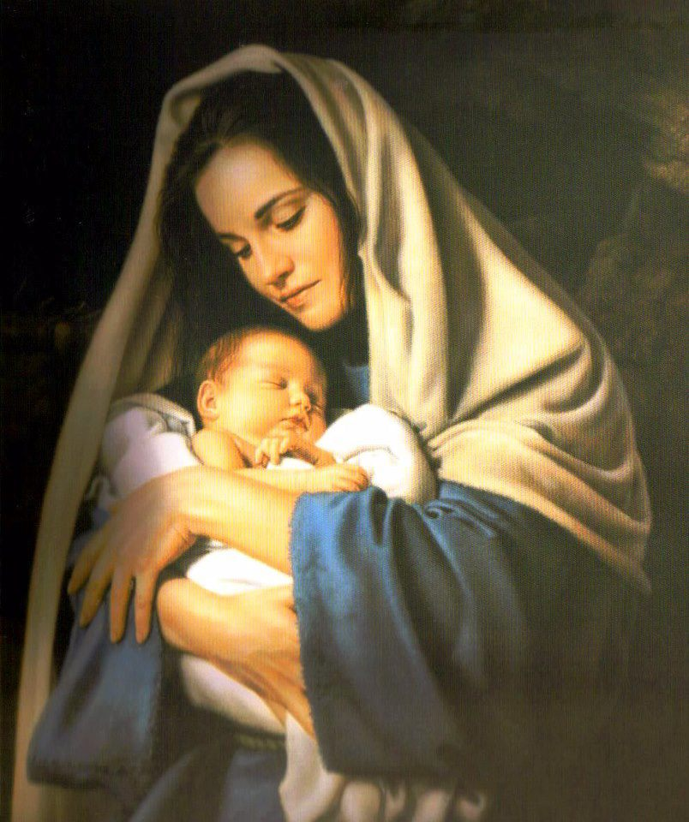
2. Mary’s love for Jesus

Slide 8
Luke 2
6 While they were there, the time came for the baby to be born, 7 and she gave birth to her firstborn, a son. She wrapped him in cloths and placed him in a manger, because there was no guest room available for them.
19 But Mary treasured up all these things and pondered them in her heart.
34 Then Simeon blessed them and said to Mary, his mother: “This child is destined to cause the falling and rising of many in Israel, and to be a sign that will be spoken against, 35 so that the thoughts of many hearts will be revealed. And a sword will pierce your own soul too.”
New International Version

Slide 9
2. Mary’s love for Jesus
There is a natural love between mother and child.
She has gone through nine long months, and the pain of childbirth
But Mary’s love is indicated in many other ways.
By treasured is meant “preserve” or “keep in mind”.
By pondered is meant to think deeply or reflect on something.
And the love continued even up to and after Jesus’ death.
Love always protects, always trusts, always hopes, always perseveres (1 Corinthians 13:7).

Slide 10
3. God’s love for sinners

Slide 11
John 3:16
For God so loved the world
that he gave his one and only Son,
that whoever believes in him
shall not perish but have eternal life.
New International Version

Slide 12
3. God’s love for sinners
The central love theme of Christmas.
God’s love for sinners.
Why was Jesus born into our world at Christmas? The angel’s words to Joseph and Mary in Matthew 1 gives the answer
“She will give birth to a son, and you are to give him the name Jesus, because he will save his people from their sins” (verse 21).
Later, Jesus himself explains the same in John 3:16.

Slide 13
3. God’s love for sinners
The Love of God is UNCONDITIONAL
The Love of God is SACRIFICAL
The Love of God is VALUABLE
The Love of God is PERSONAL
The Love of God is ACCESSIBLE to all
The Love of God is NOT JUDGMENTAL

Slide 14
3. God’s love for sinners
Jesus didn’t come into the world in order to rebuke you. He came to rescue you.
He didn’t come to criticize you. He came to cleanse you.
He didn’t come to punish you. He came to pardon you.
He didn’t come to destroy you. He came to deliver you.

Slide 15
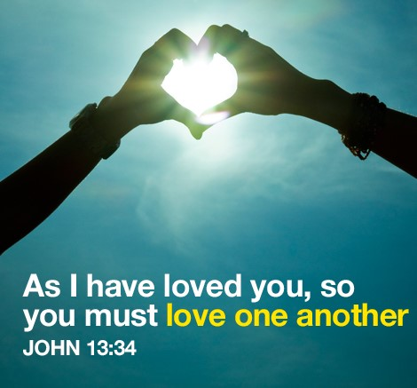
4. Our love for one another

Slide 16
1 John 4:10-11
This is love: not that we loved God, but that he loved us and sent his Son as an atoning sacrifice for our sins. Dear friends, since God so loved us, we also ought to love one another.
New International Version

Slide 17
4. Our love for one another
God’s love comes first
His Love in creating the world
His Love in promising a savior
His Love in sending His son
His love in Jesus dying on the cross for our sins
But then love should follow.
Our love for others should follow, not merely as an obligation but as a natural outflow of God’s love for us.

Slide 18
Challengers
Seek out the God of love. The God who gave His son as a sacrifice for our sins
Knowing that God showed his love for us at Christmas by sending his Son into the world as a sacrifice for our sins. How will you show your love to others this Christmas?

